Slide 1
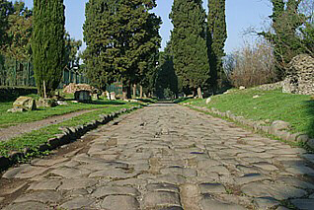
The Road of Victory
Romans 8:31-39
The Appian Way
Preaching through Romans
May 26, 2013

Slide 2
What, then, shall we say in response to this?

Slide 3
What, then, shall we say in response to this?
Justified by faith…
New life…
No condemnation…
Children of God…
The gain outweighs the pain…

Slide 4
If God is for us, who can stand against us?

Slide 5
What a statement…
God is for us!
Who can stand against us?
No one!

Slide 6
32 Since God did not spare his own Son, but gave him up for us all—how will he not also, along with him, graciously give us all things?

Slide 7
What can we expect from God?
Everything!
He has already given his most wonderful and best.
Romans 5:8
“God shows his love for us in this: while we were still sinners Christ died for us.”

Slide 8
33 Who will bring any charge against those whom God has chosen? It is God who justifies.
Who is he that condemns?...

Slide 9
The world is full of condemnation
Who can condemn?...
God has chosen…
God justified…
Who can condemn?...
No One

Slide 10
Jesus Christ, died—more than that, who was raised to life—is at the right hand of God and is also interceding for us.

Slide 11
Do we need more?
Jesus died – so all sins all failures were marked “PAID” on the cross
Jesus lives – so he lives in us
Jesus even pleads your case before the Father
So God does not condemn you

Slide 12
35 Who shall separate us from the love of Christ? Shall trouble or hardship or persecution or famine or nakedness or danger or sword?

Slide 13
We are never separated from God’s love
He is with us through all the issues of living

Slide 14
36 As it is written:
“For your sake we face death all day long; we are considered as sheep to be slaughtered.”

Slide 15
Martyr comes from the Greek which means a witness.
Their commitment brought the growth of our faith.
More Christians died for their faith in the past 100 years than in roman arenas.
Where they die the Church of God grows.
Commitment and sacrifice are the expressions of our witness of faith

Slide 16
37 No, in all these things we are more than conquerors through him who loved us.

Slide 17
List your fears…
What frightens you?
Then scratch them off the list!

Slide 18
38 For I am convinced that neither death nor life, neither angels nor demons, neither the present nor the future, nor any powers, neither height nor depth,

Slide 19
List your fears…
What frightens you?
God has scratched them off the list!
“There is no pit so deep, that God is not deeper still.” Cory Ten Boom

Slide 20
nor anything else in all creation, will be able to separate us from the love of God that is in Jesus Christ our Lord.

Slide 21
The love of God is proven in Jesus Christ

Slide 22
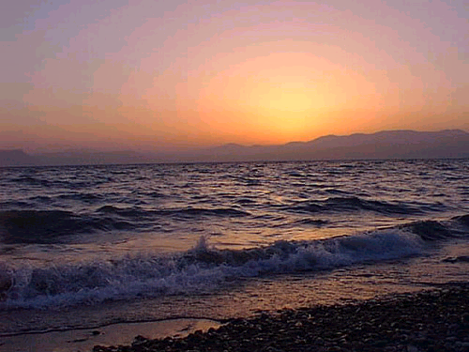
And the peace of God which surpasses all human understanding, keep your hearts and minds in Jesus Christ unto eternal life.

Slide 23
Amen

